Slide 1
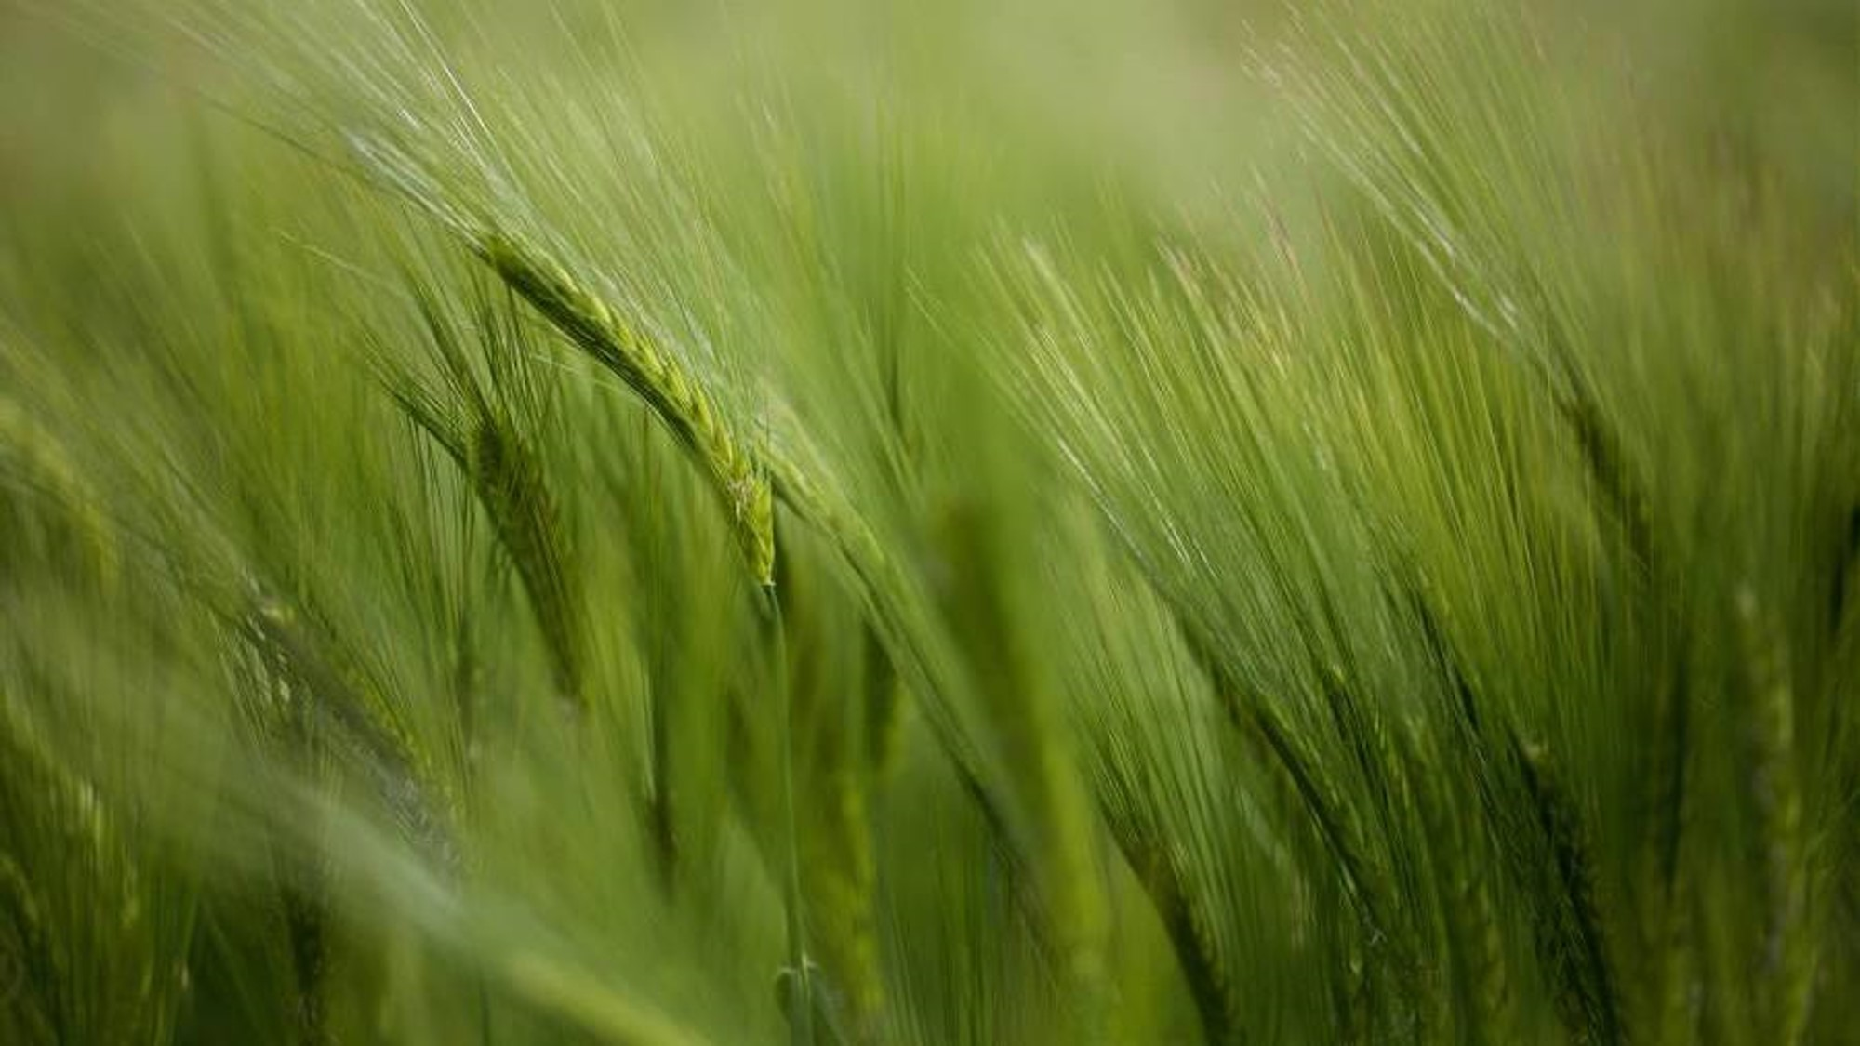
Agri-Route :Optimized Multi Stage Agricultural Supply Chain By-Team Hustlers(AG30)

Slide 2

AGENDA
To present an innovative solution for agricultural supply chain optimization.
Develop an optimization algorithm tailored for multi-stage supply chains .
Prioritize practicality and robustness to handle real-world agricultural supply chain challenges

Slide 3
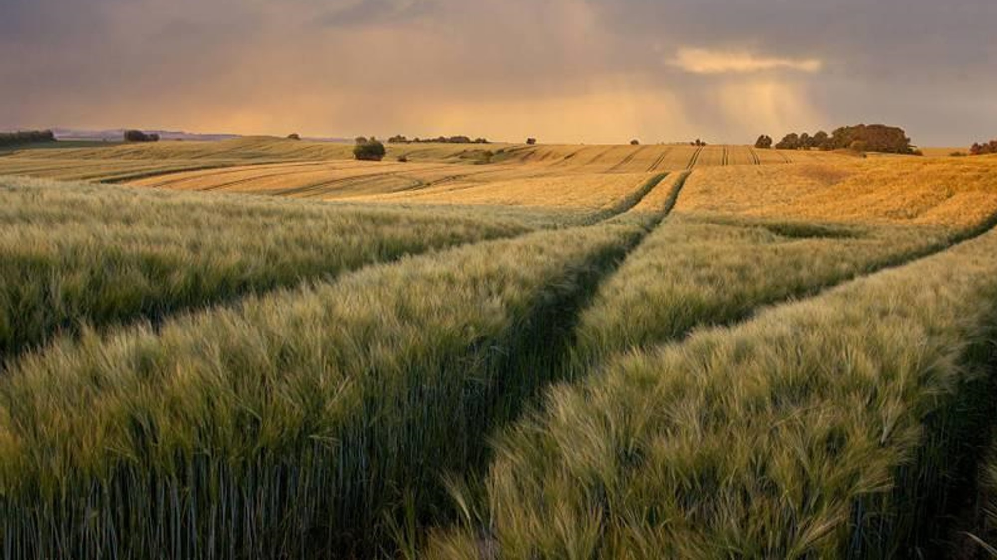
Simulation and Dataset generator

Slide 4
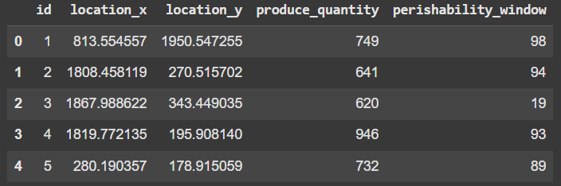
Dataset generation and modelling of problem statement
After generating random points for farm, Hub and Center we created two distance matrices of order n*m and m*k
Then we created dataset considering the factors such as:
Distance &size of vehicles used (cost matrix)
Perishability matrix of order n*1
Storage matrix of m*1
Demand matrix of k*1

Slide 5
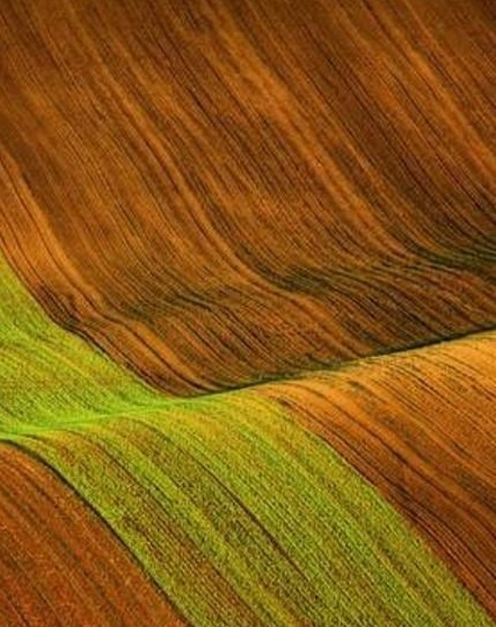
Algorithm design and implementation

Slide 6
AlgoRithm central idea
This code implements two algorithms to optimize routes in a multi-stage agricultural supply chain:
1)Greedy(being the baseline algo)
2)Novel approach(Explore all possible routes between farms, hubs, and centers to find the most cost-efficient allocation based on the distance ,cost and demand matrix while adhering to constraints.)

Slide 7
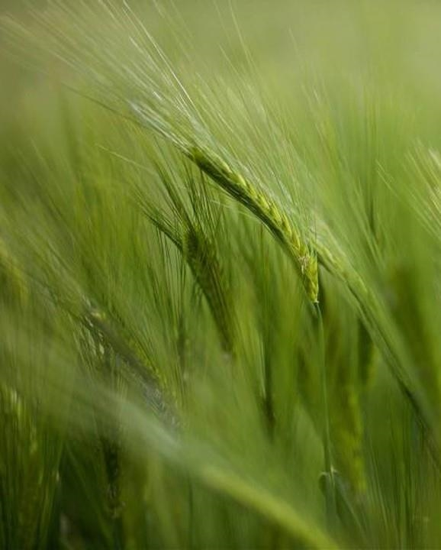
Modelling the problem statement("Turning Complexity into Clarity”)
.

Slide 8
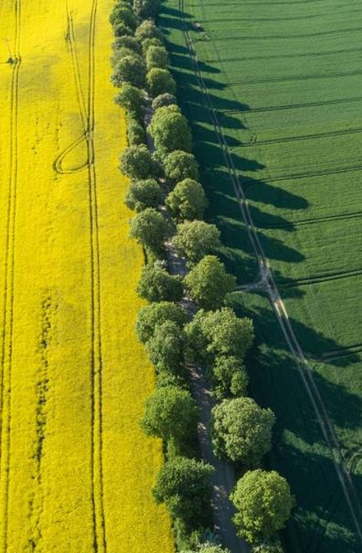
Algorithm breakdown
We compared both the algorithms and found that Novel algorithm is better than greedy algorithm in terms of delivery time and costs .
However, the time may still be longer than the Greedy Algorithm if it leads to longer travel distances in certain cases, though it generally offers a better overall balance of time and cost.
Spoilage cost arises when the delivery time exceeds the perishability window of the farm’s produce. The Greedy Algorithm may result in higher spoilage costs if it chooses paths that exceed the perishability window.
Novel approach is expected to perform better in terms of spoilage costs because it considers all possible combinations of routes, potentially selecting routes that minimize spoilage.

Slide 9
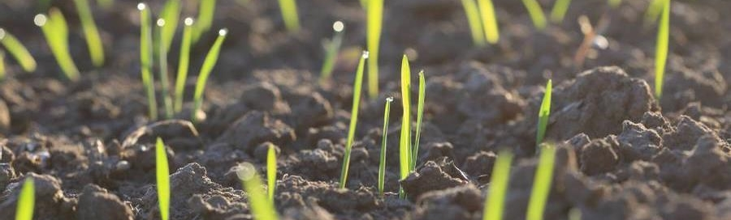
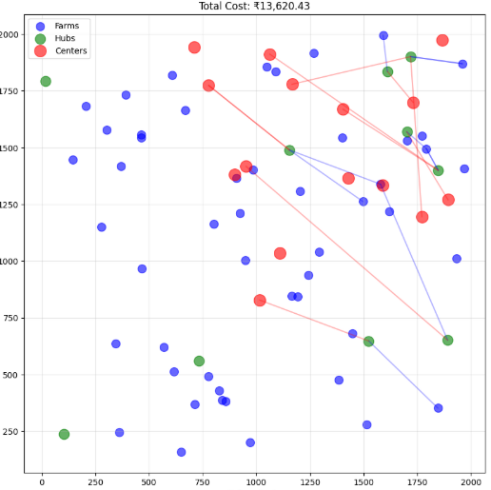
Output and Final conclusion
An Undirected graph in which the nodes represent the farms, hub and centers and edges between them shows the optimal path to be chosen for transportation via the two approaches .

Slide 10
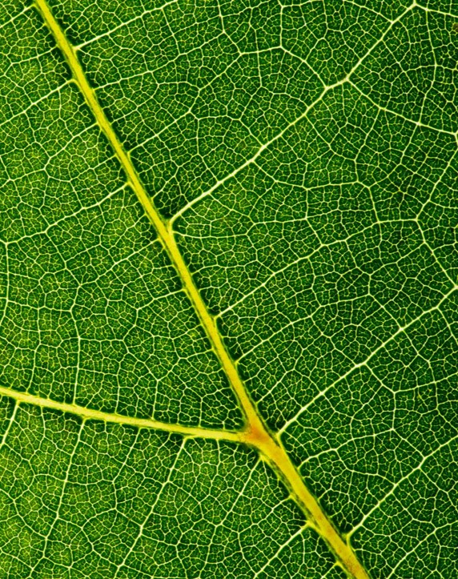
Thank you
Team-Hustlers
Aditya Pratap Singh(Team Leader)
Ankur Sharma
Aditya Kumar Singh
Hemant Pathak
Archisman Adhikari

